Slide 1
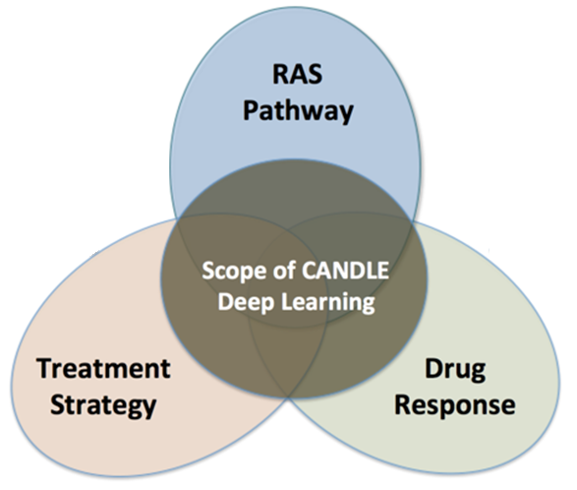
An Introduction to Scalable Deep Learning with CANDLE
OPTIMAL DEEP LEARNING On EXASCALE computers
erhtjhtyhy
Justin M Wozniak
JAMAL MOHD-YUSOF
Computer Scientist
Mathematics & Computer Science
Argonne National Laboratory
Future Architectures and Applications
CCS-7 Applied Computer Science Group
Los Alamos National Laboratory
Exascale Computing Project 2nd Annual Meeting
February 6, 2018

Slide 2
OUTLINE
Overview of CANDLE project
Deep learning benchmarks
Introduction to neural networks and Keras
Tutorial: CANDLE Benchmark structure
Overview of hyperparameter optimization
Introduction to hyperparameter optimization
Workflow-based solution: EMEWS
Machine learning applications in cancer research: CANDLE/Supervisor
Tutorial: Hyperparameter pptimization of a CANDLE Benchmark

Slide 3
CANDLE TUTORIALS
May be found here: https://github.com/ECP-CANDLE/Tutorials
See the top-level README to get started with the installation

Slide 4
CaNcer Deep Learning Environment (CANDLE)

Slide 5
CANDLE
CANDLE (PI: Rick Stevens) is an Argonne led multi-DOE lab collaboration developing a suite of software to support scalable deep learning for cancer applications on DOE supercomputing resources
Funded by the DOE Exascale Computing Project
Developing implementations of deep neural networks on targeted problems related to the three core DOE-NCI Joint Design of Advanced Computing Solutions for Cancer (JDACS4C) pilot projects
GitHub: http://github.com/ECP-CANDLE

Slide 6
CANDLE Goals
Develop an exascale deep learning environment for cancer
Building on open source deep learning frameworks
Optimization for CORAL and exascale platforms
Support all three pilot project needs for deep learning
Collaborate with DOE computing centers, HPC vendors and ECP co-design and software technology projects
Mission statement: Enable the most challenging deep learning problems in cancer research to run on the most capable supercomputers in the DOE

Slide 7
Driving integration of Simulation, Data Analytics and Machine Learning
Traditional
HPC
Systems
Scalable
Data Analytics
Large-Scale
Numerical
Simulation
CORAL Supercomputers
and Exascale Systems
Deep
Learning

Slide 8
CANDLE Software Stack
Hyperparameter Sweeps,
Data Management (e.g. DIGITS, Swift, etc.)
Workflow
Network description, Execution scripting API
(e.g. Keras, Mocha)
Scripting
Tensor/Graph Execution Engine
(e.g. Theano, TensorFlow, LBANN-LL, etc.)
Engine
Architecture Specific Optimization Layer
(e.g. cuDNN, MKL-DNN, etc.)
Optimization

Slide 9
CANDLE: Benchmarks

Slide 10

P1B1: Autoencoder Compressed Representation for Gene Expression
Overview: Given a sample of gene expression data, build a sparse autoencoder that can compress the expression profile into a low-dimensional vector
Relationship to core problem: Many molecular assays generate large numbers of features that can lead to time-consuming processing and over-fitting in learning tasks; hence, a core capability we intend to build is feature reduction
Expected outcome: An autoencoder that collapse high dimensional expression profiles into low dimensional vectors

Slide 11
P1B1: Benchmark Specs Requirements
Description of the Data
Data source: RNA-seq data from GDC
Input dimensions: 60,484 floats; log(1+x) transformed FPKM-UQ values
Output dimensions: Same as input
Latent representation dimension: 1000
Sample size: 5,000
Expected Outcomes
Reconstructed expression profiles
Output range: float; same as log transformed input
Evaluation Metrics
Accuracy or loss function: mean squared error
Expected performance of a naïve method: landmark genes picked by linear regression
Description of the Network
Proposed network architecture: MLP with encoding layers, dropout layers, bottleneck layer, and decoding layers
Number of layers: At least two hidden layers in encoding and decoding
Annotated Keras Code
Data loader, preprocessing, basic training and cross validation, prediction and evaluation on test data

Slide 12
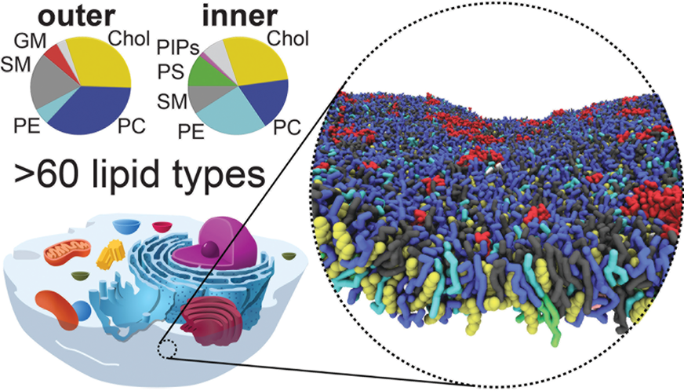
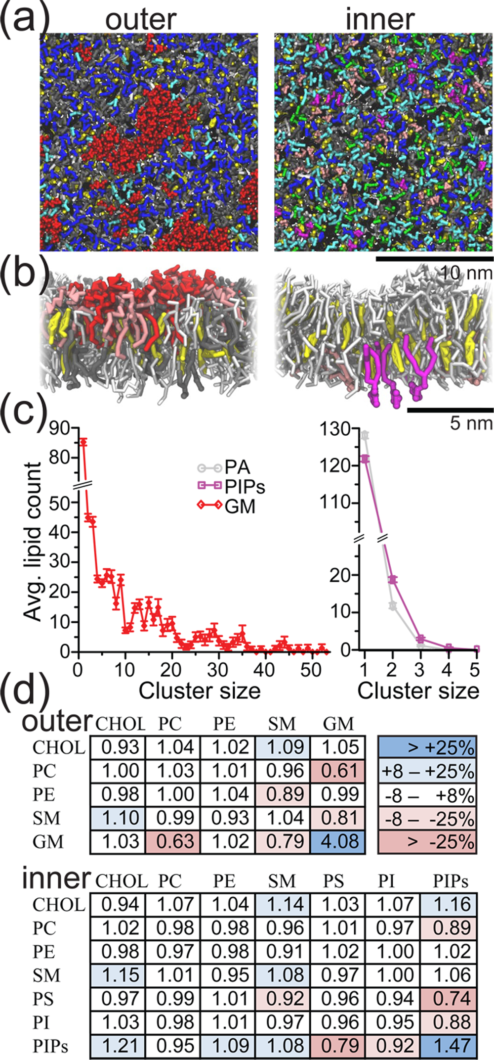
P2B1: Autoencoder
Goal: Generate automatically extracted features representing molecular simulation data
Relationship to core problem: Establish framework for building future tools using learned features
Expected outcome: Improvement in the understanding of protein formation and easing of the handling large-scale molecular dynamics output
Lipid Organization of the Plasma Membrane
Helgi I. Ingólfsson et al.
J. Am. Chem. Soc., 2014, 136 (41), pp 14554–14559

Slide 13
P2B1: Benchmark Specs Requirements
Description of the Data
Data source: MD Simulation output as PDB files
Input dimensions: ~1000x1000 per time step
Output dimensions: 500
Latent representation dimension
Sample size: O(10⁷) time steps
Notes on data balance and other issues: unlabeled data with rare events
Expected Outcomes
Reconstructed MD simulation state
Output range: automatically learned features that discriminate the data set
Evaluation Metrics
Accuracy or loss function: L2 reconstruction error
Expected performance of a naïve method: N/A
Description of the Network
Proposed network architecture: stacked fully-connected autoencoder
Number of layers: 5-8
Annotated Keras Code
Data loader, preprocessing, basic training and cross validation, prediction and evaluation on test data

Slide 14
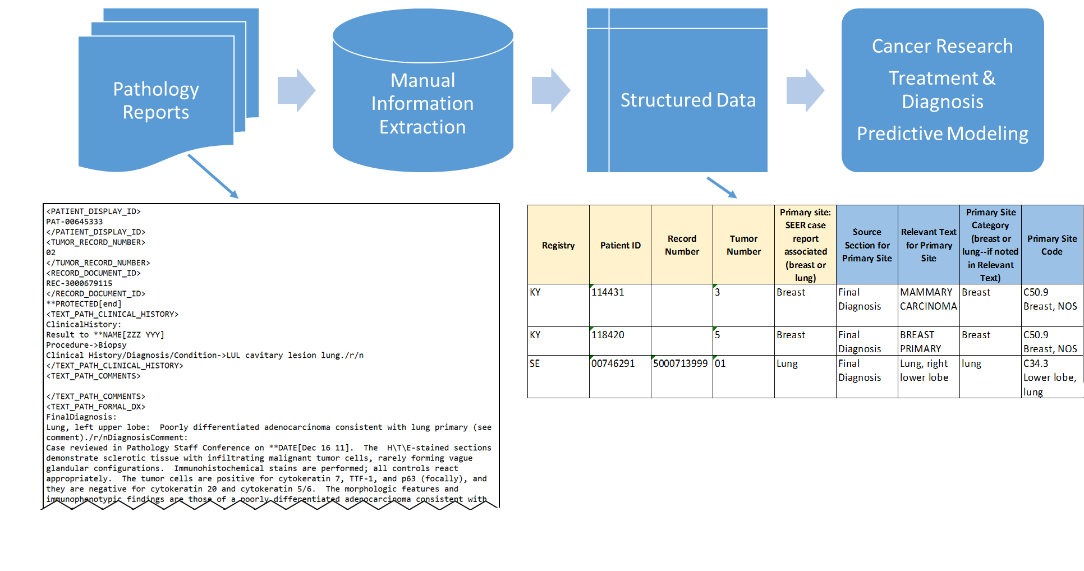
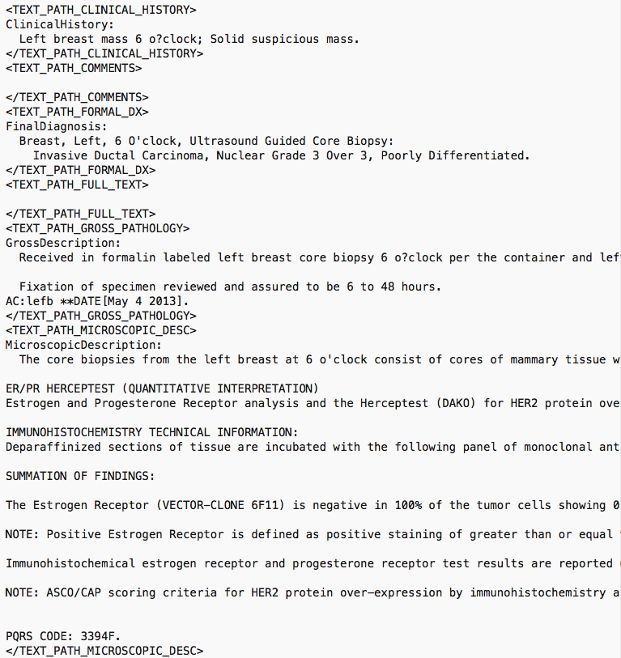
P3B1: RNN-LSTM: Generative models for Path Reports
Overview: Given a sample corpus of biomedical text such as clinical reports, build a deep learning network that can automatically generate synthetic text documents with valid clinical context
Relationship to core problem: Labeled data is quite challenging to come by, specifically for patient data, since manual annotations are time consuming; hence, a core capability we intend to build is a “gold-standard” annotated data that is generated by deep learning networks to tune our deep text comprehension applications
Expected outcome: A generative RNN based on LSTMs that can effectively generate synthetic biomedical text of desired clinical context
location of tumor
type of tumor

Slide 15
P3B1: Benchmark Specs Requirements
Description of the Data
Data source: Annotated pathology reports
Input dimensions: 250,000-500,000 [characters], or 5,000-20,000 [bag of words], or 200-500 [bag of concepts]
Output dimensions: Same as input
Sample size: O(1,000)
Notes on data balance and other issues: standard NLP pre-processing is required, including (but not limited to) stemming words, keywords, cleaning text, stop words, etc. Data balance is an issue since the number of positive examples vs. control is skewed
Expected Outcomes
A generative model for pathology reports
Output range: N/A, since the outputs are actual text documents with known case descriptions/ concepts
Evaluation Metrics
Accuracy or loss function: Standard information theoretic metrics such as log-likelihood score, minimum description length score, AIC/BIC to measure how similar actual vs. generated documents are
Expected performance of a naïve method: Latent Dirichlet allocation (LDA) models
Description of the Network
Proposed network architecture: LSTM with at least 4 layers and [128, 256, 512] character windows
Number of layers: At least two hidden layers with one input and one output sequence
Annotated Keras Code
Data loader, preprocessing, basic training and cross validation, prediction and evaluation on test data

Slide 16
CANDLE benchmark spec
Overall goal:
To enable the hyperparameter search and UQ (and more?) workflows in a consistent, convenient way
Standardized network specification format
default_model_file
Standardized command line intercept protocol
Overwrite the default model as needed
Standardized initialize and run protocol
Use same defaults across frameworks
run(gParameters)

Slide 17
CANDLE benchmark spec
Overview
Coded in Keras
Applicable to a variety of ML problems
Can target multiple execution frameworks including Tensorflow, Theano, CNTK, mxNet
Each framework may have different default parameters
Leverage existing packages: numpy, pandas, etc.
Provides various utility packages
Default_utils.py
File_utils.py
Data_utils.py
Keras_utils.py

Slide 18
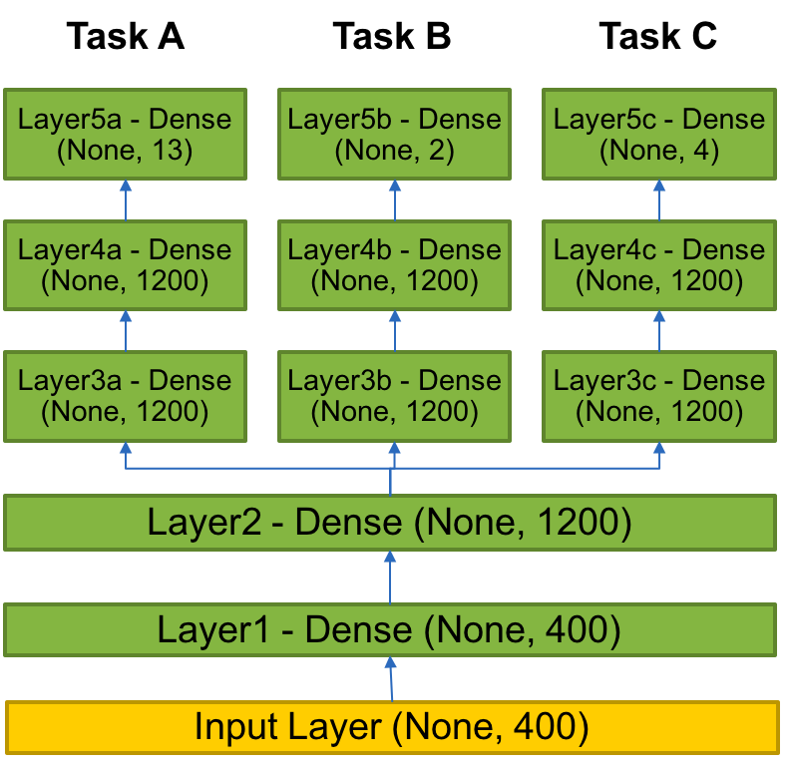
Example benchmark
P3B1
P3B1: Multi-task Deep Neural Net (DNN) for data extraction from clinical reports
Overview: Given a corpus of patient-level clinical reports, build a deep learning network that can simultaneously identify:(i) b tumor sites, (ii) t tumor laterality, and (iii) g clinical grade of tumors.
Relationship to core problem: Instead of training individual deep learning networks for individual machine learning tasks, Build a multi-task DNN that can exploit task-relatedness to simultaneously learn multiple concepts.
Expected outcome: Multi-task DNN that trains on same corpus and can automatically classify across three related tasks.

Slide 19
Original code
Hard coded hyperparameters
shared_nnet_spec= [ 1200 ]
individual_nnet_spec0= [ 1200, 1200 ]
individual_nnet_spec1= [ 1200, 1200 ]
individual_nnet_spec2= [ 1200, 1200 ]
individual_nnet_spec = [ individual_nnet_spec0, individual_nnet_spec1, individual_nnet_spec2 ]
a
learning_rate = 0.01
batch_size = 10
n_epochs = 10
dropout = 0.0
## Read files
from data_utils import get_file
origin = 'http://ftp.mcs.anl.gov/pub/candle/public/benchmarks/P3B1/P3B1_data.tgz’
data_loc = get_file('P3B1_data.tgz', origin, untar=True, md5_hash=None, cache_subdir='P3B1')

Slide 20
Default model file
P3B1
data_url = 'ftp://ftp.mcs.anl.gov/pub/candle/public/benchmarks/P3B1/’
train_data = 'P3B1_data.tar.gz’
model_name = 'p3b1’
learning_rate = 0.01
batch_size = 10
epochs = 10
drop = 0.0
activation = 'relu’
out_activation = 'softmax’
loss = 'categorical_crossentropy’
optimizer = 'sgd’
metrics = 'accuracy’
n_fold = 1
shared_nnet_spec = '1200’
ind_nnet_spec = '1200, 1200:1200, 1200:1200, 1200’
feature_names = 'Primary site:Tumor laterality:Histological grade’
timeout =1800
scaling = 'none’
output_dir = '.’
initialization='glorot_uniform’

Slide 21
Network specification
Shared layers
# input layer
layer = Input( shape = ( input_dim, ), name= 'input' )
shared_layers.append( layer )
# shared layers
for k in range( len( shared_nnet_spec ) ):
layer = dense( shared_nnet_spec[ k ], activation=gParameters['activation'],
name= 'shared_layer_' + str( k ) )( shared_layers[ -1 ] )
shared_layers.append( layer )
if gParameters['drop'] > 0:
layer = Dropout( gParameters['drop'] )( shared_layers[ -1 ] )
shared_layers.append( layer )
# individual layers
indiv_layers_arr = []
models = []

Slide 22
Network specification
Individual layers specified with Keras objects
for l in range( len( individual_nnet_spec ) ):
indiv_layers = [ shared_layers[-1] ]
for k in range( len( individual_nnet_spec[l] ) + 1 ):
if k < len( individual_nnet_spec[l] ):
layer = Dense( individual_nnet_spec[l][k],
activation=gParameters['activation’],
name= 'indiv_layer_%i_%i' % (l,k) ) \ # Function!
( indiv_layers[-1] )
indiv_layers.append( layer )
if gParameters['drop'] > 0:
layer = Dropout( gParameters['drop'] )( indiv_layers[-1] )
indiv_layers.append( layer )
else:
layer = Dense( n_out_nodes[l], activation=gParameters['out_activation’],
name= 'out_%i‘ % l ) \ # Function! ( indiv_layers[-1] )
indiv_layers.append( layer )
indiv_layers_arr.append( indiv_layers )
model = Model( inputs=[shared_layers[0]], outputs=[indiv_layers[-1]] )
models.append( model )

Slide 23
Parsing command line input
Overwrite the default model values with any command line options
(including specifying a new default model file)
# Parse common parameters
bmk.parse_from_common()
# Parse parameters that are applicable just to benchmark bmk.parse_from_benchmark()
# Get command-line parameters
args = bmk.parser.parse_args()
#print('Args:', args)
# Get parameters from configuration file
fileParameters = bmk.read_config_file(args.config_file)
#print ('Params:', fileParameters)
# Consolidate parameter set. Command-line parameters overwrite file configuration gParameters = args_overwrite_config(args, fileParameters)
print ('Params:', gParameters)
return gParameters

Slide 24
Modifying the model
Various ways to overwrite the default model file values
Provide a new default model specification
--config_file new_default_model.txt
Overwrite individual parameters in the default model
--learning_rate 0.1 –drop 0.1
Provides an easy way to perform individual experiments to probe the hyperparameter space
Provides the pathway for automated sweeps of hyperparameters
→ Supervisor workflows

Slide 25
TUTORIAL: BENCHMARKS

Slide 26
HANDS-ON TUTORIAL: BENCHMARKS
May be found here: https://github.com/ECP-CANDLE/Tutorials
See the top-level README to get started with the installation

Slide 27
CANDLE: WORKFLOWS

Slide 28
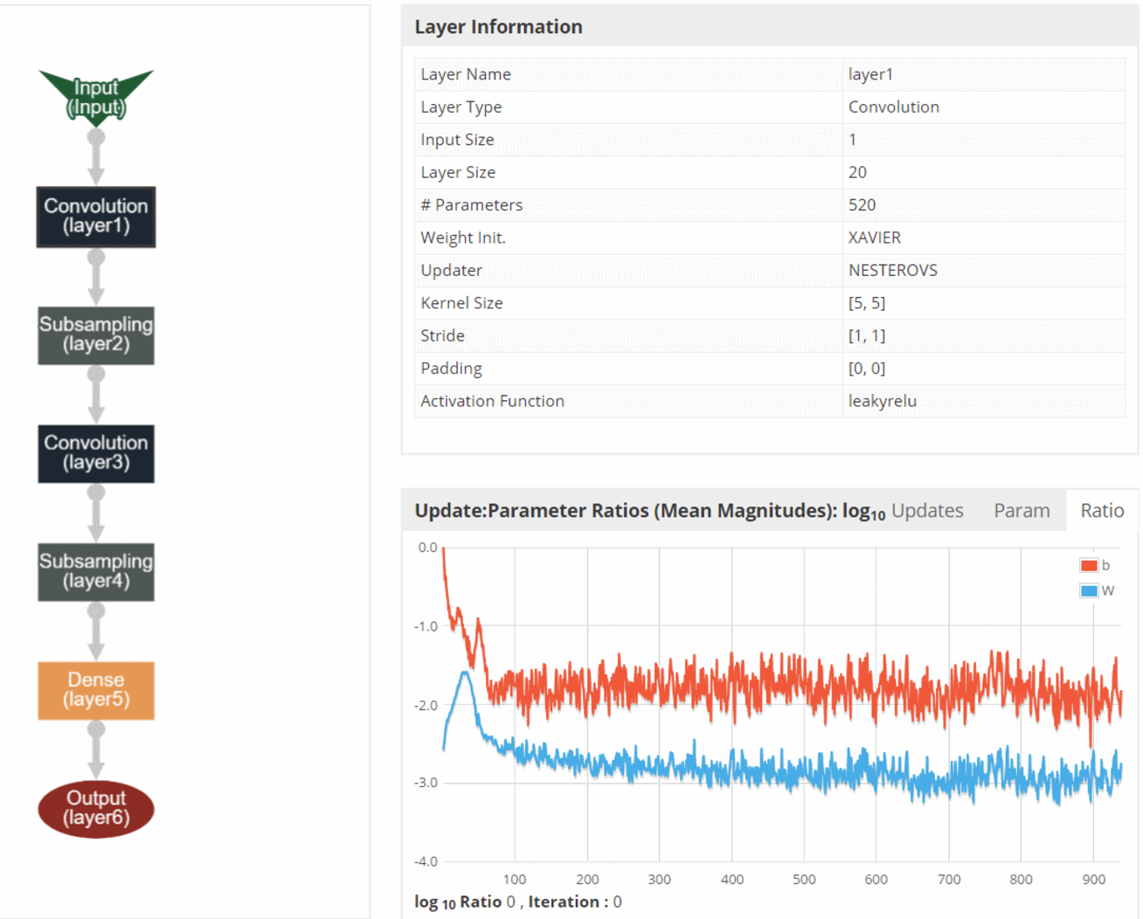
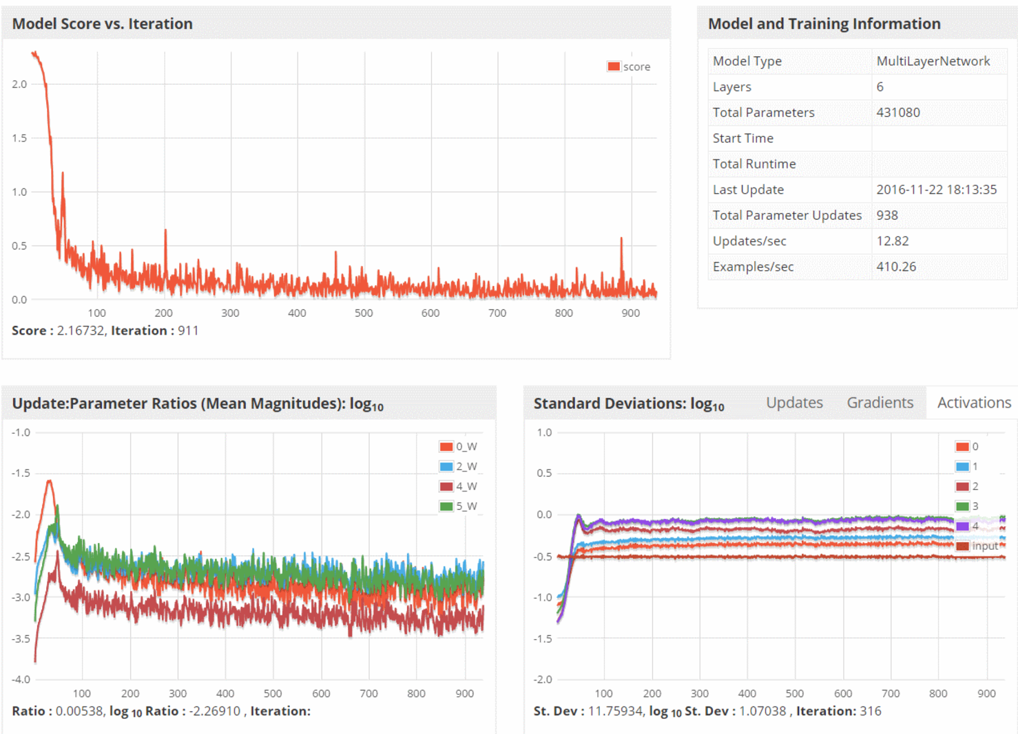
CANDLE System Overview
ML/DL Benchmarks
Pilot 1
Pilot 2
Pilot 3
CANDLE Database
CANDLE Specifications
Metadata Store
Model Store
Integrator Website
Benchmark Spec
Hyperparameter Spec
Hardware Spec
Benchmarks
Datasets
Models
Experiments
Runs
Model Descriptions
CANDLE Supervisor
Model Weights
Hyperparameter Optimization Frameworks
Hyperopt, mlrMBO, Spearmint
Workflow Manager
(Swift-T EMEWS)
Data API
ALCF
Theta, Cooley
NERSC
Cori
OLCF
Titan, SummitDev
Hardware Resources

Slide 29
Parallelism strategies
10,000 x 10-1000 x 10-100 = 1M – 1000M processing elements
Hyperparameter Search: up to ~10,000x
Depends on search strategy
Data Parallel: 10x-1000x
Data Parallel
10x-1000x
Model
Parallel
10x-100x
Model
Parallel
10x-100x
Model
Parallel
10x-100x
Model
Parallel
10x-100x
Model
Parallel
10x-100x
...
...
...

Slide 30
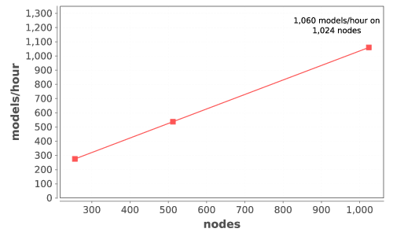
CANDLE Performance
Delivers 1+ petaflop!

Slide 31
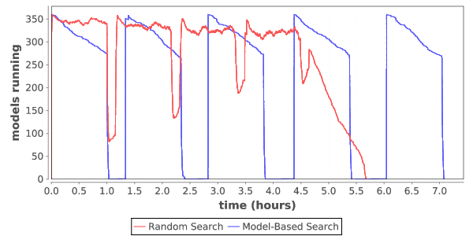
Load over time for search
Typical load plot for NT3 workflow on Cori

Slide 32
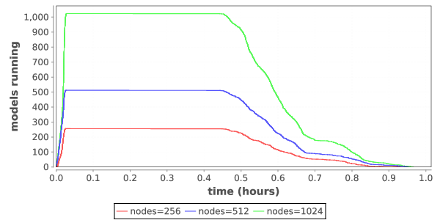
Ramp up / ramp down
Zoom in on single iteration on Titan

Slide 33
HYPERPARAMETER OPTIMIZATION

Slide 34
WHAT IS HYPERPARAMETER OPTIMIZATION
Hyperparameter optimization = HPO
Neural networks have a large number of possible configuration parameters, called hyperparameters
Avoids collision with NN weights, which are sometimes called parameters
Applying optimization can automate part of the design of the neural network
In the cancer Pilot 1 autoencoder shown, the system can determine
How many neurons to put in each layer
What activation function to use
What batch size to use
Etc.

Slide 35
Mathematical expression for hpo
For a given problem:
A loss function F is determined on a given NN (usually accuracy)
The hyperparameter optimization problem is to minimize F(p),
for all hyperparameter sets p in the valid parameter space P,
however, P is large and F is expensive.
P is the cross product of all valid network settings,
some of which may be categorical, some integer, some continuous.
Evaluating F involves training the network on a training data set and applying it to the validation set
We can use a generic, previously developed method to optimize F !
These methods require and can use large compute resources

Slide 36
BASIC STRATEGIES
Grid search
Random search
Generic optimization
Stochastic gradient descent
Evolutionary algorithms
Model-based optimization
NN hyperparameter-specific optimization
Hyperopt, NEAT, Optunity, …

Slide 37
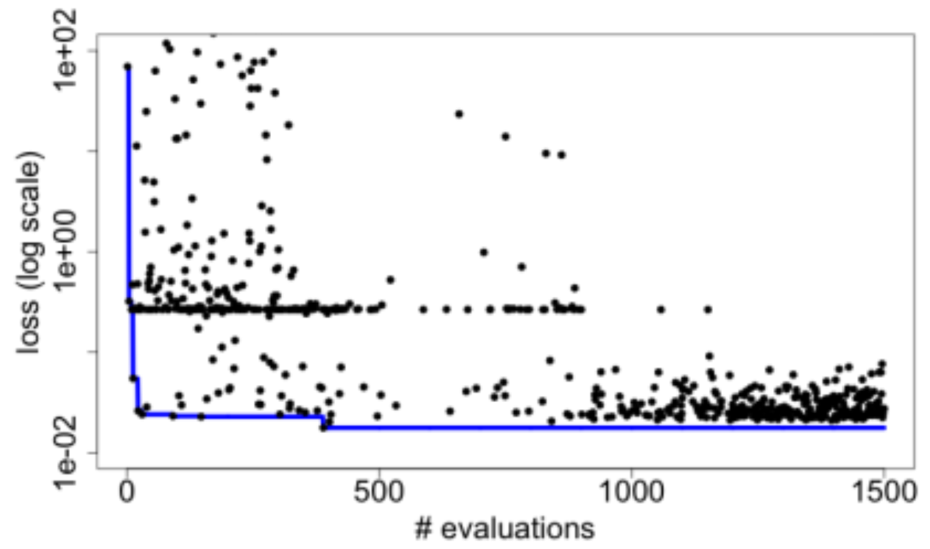
Candle Hyperparameter learning
Search trajectory of mlrMBO (R model-based optimization) algorithm
Each iteration does 300 evaluations (batch size)
Minimum and average performance on validation data set decreases as the ME algorithm learns
Predicting Tumor Cell Line Response to Drug Pairs with Deep Learning, F. Xia, M. Shukla, T. Brettin, C. Garcia-Cardona, J. Cohn, J. Allen, S. Maslov, Y. Evrard, S. Holbeck, J. Doroshow, E. Stahlberg, and R. Stevens (Computational Approaches for Cancer Workshop @ SC 2017)

Slide 38
SYSTEMS CHALLENGES

Slide 39
Notes on requirements
Simulation Applications
64bit floating point
Memory Bandwidth
Random Access to Memory
Sparse Matrices
Distributed Memory jobs
Synchronous I/O multinode
Scalability Limited comm
Low Latency High Bandwidth
Large Coherency Domains help sometimes
O typically greater than I
O rarely read
Output is data
Big Data Applications
64 bit and Integer important
Data analysis Pipelines
DB including No SQL
MapReduce/SPARK
Millions of jobs
I/O bandwidth limited
Data management limited
Many task parallel
Large-data in and Large-data out
I and O both important
O is read and used
Output is data
Deep Learning Applications
Lower Precision (fp32, fp16)
FMAC @ 16 summing to 32
Inferencing can be 8 bit (TPU)
Scaled integer possible
Training dominates dev
Inference dominates pro
Data pipelines needed
Dense FP typical SGEMM
Small DFT, CNN
Ensembles and search
Single Models Small
I more important than O
Reuse of training data
Output is models

Slide 40
WORKFLOW support for ML frameworks
Concurrency:
Very fast task distributor
Intranode concurrency, accelerators left up to the framework
Multinode ML tasks are future work (already basically supported)
Data management:
Input staging methods have been developed
Intermediate caches via DataSpaces
Software integration:
Usually launch frameworks in separate process
Launching within process is a configuration challenge
Search methods launched within process

Slide 41
The Swift programming model
All progress driven by concurrent dataflow
(int r) myproc (int i, int j)
{
int x = F(i);
int y = G(j);
r = x + y;
}
F() and G() implemented in native code or external programs
F() and G()run in concurrently in different processes
r is computed when they are both done
This parallelism is automatic
Works recursively throughout the program’s call graph

Slide 42
Language goals
Hierarchical, naturally parallel, script-like programming
Make it easy to run large batteries of external program or library executions
Provide rich programming language at the top level – fully generic
Support implicit concurrency and conventional programming constructs
Enable complex tasks based in other scripting languages (e.g., Python) or parallel MPI tasks

Slide 43
Swift syntax
Data types
int i = 4;
string s = "hello world";
file image<"snapshot.jpg">;
Shell access
app (file o) myapp(file f, int i)
{ mysim "-s" i @f @o; }
Structured data
typedef image file;
image A[];
type protein_run {
file pdb_in; file sim_out;
}
bag<blob>[] B;
Conventional expressions
if (x == 3) {
y = x+2;
s = strcat("y: ", y);
}
Parallel loops
foreach f,i in A {
B[i] = convert(A[i]);
}
Data flow
merge(analyze(B[0], B[1]),
analyze(B[2], B[3]));
Swift: A language for distributed parallel scripting. J. Parallel Computing 2011
Compiler techniques for massively scalable implicit task parallelism. Proc. SC 2014

Slide 44
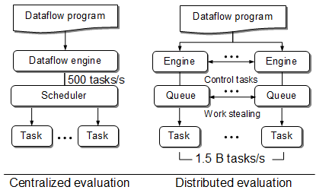
Centralized evaluation is a bottleneck at extreme scales
Had this (Swift/K):
Now have this (Swift/T):
Turbine: A distributed-memory dataflow engine for high performance many-task applications. Fundamenta Informaticae 28(3), 2013

Slide 45
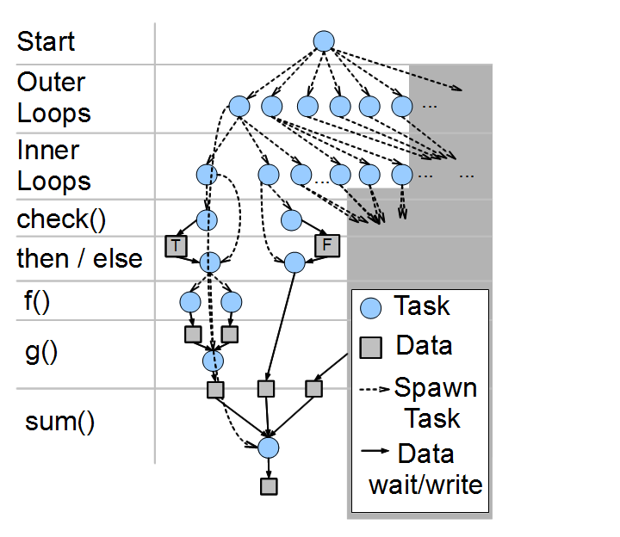
Swift/T: Fully parallel evaluation of complex scripts
int X = 100, Y = 100;
int A[][];
int B[];
foreach x in [0:X-1] {
foreach y in [0:Y-1] {
if (check(x, y)) {
A[x][y] = g(f(x), f(y));
} else {
A[x][y] = 0;
}
}
B[x] = sum(A[x]);
}
Swift/T: Scalable data flow programming for distributed-memory task-parallel applications . Proc. CCGrid, 2013.

Slide 46

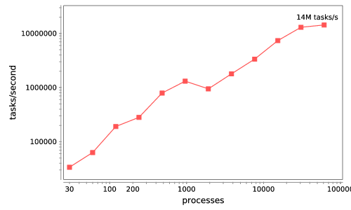






Swift/T: Enabling high-performance Scripted workflows
Supports tasks written in many languages
Write site-independent scripts
Automatic parallelization and data movement
Run native code, script fragments as applications
Rapidly subdivide large partitions for MPI jobs
Move work to data locations
Swift/T worker
Swift/T control process
Swift worker process
C
C++
Fortran
C
C++
Fortran
C
C++
Fortran
MPI
64K cores of Blue Waters
2 billion Python tasks 14 million Pythons/s
Interlanguage parallel scripting for distributed-memory scientific computing. Proc. WORKS @ SC 2015

Slide 47
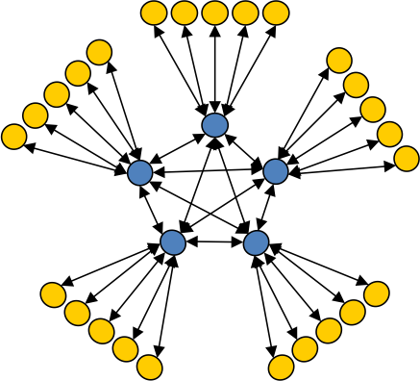
Asynchronous Dynamic Load Balancer
workers
ADLB for short
An MPI library for master-worker workloads in C
Uses a variable-size, scalable network of servers
Servers implement work-stealing
The work unit is a byte array
Optional work priorities, targets, types
For Swift/T, we added:
Server-stored data
Data-dependent execution
masters
Lusk et al. More scalability, less pain: A simple programming model and its implementation for extreme computing. SciDAC Review 17, 2010

Slide 48
Swift/T: Enabling high-performance Scripted workflows
Supports tasks written in many languages
Write site-independent scripts
Automatic parallelization and data movement
Run native code, script fragments as applications
Rapidly subdivide large partitions for MPI jobs
Move work to data locations
Swift/T worker
Swift/T control process
Swift worker process
C
C++
Fortran
C
C++
Fortran
C
C++
Fortran
MPI
64K cores of Blue Waters
2 billion Python tasks 14 million Pythons/s
Interlanguage parallel scripting for distributed-memory scientific computing. Proc. WORKS @ SC 2015

Slide 49
Extreme-scale model exploration with Swift (EMEWS)

Slide 50
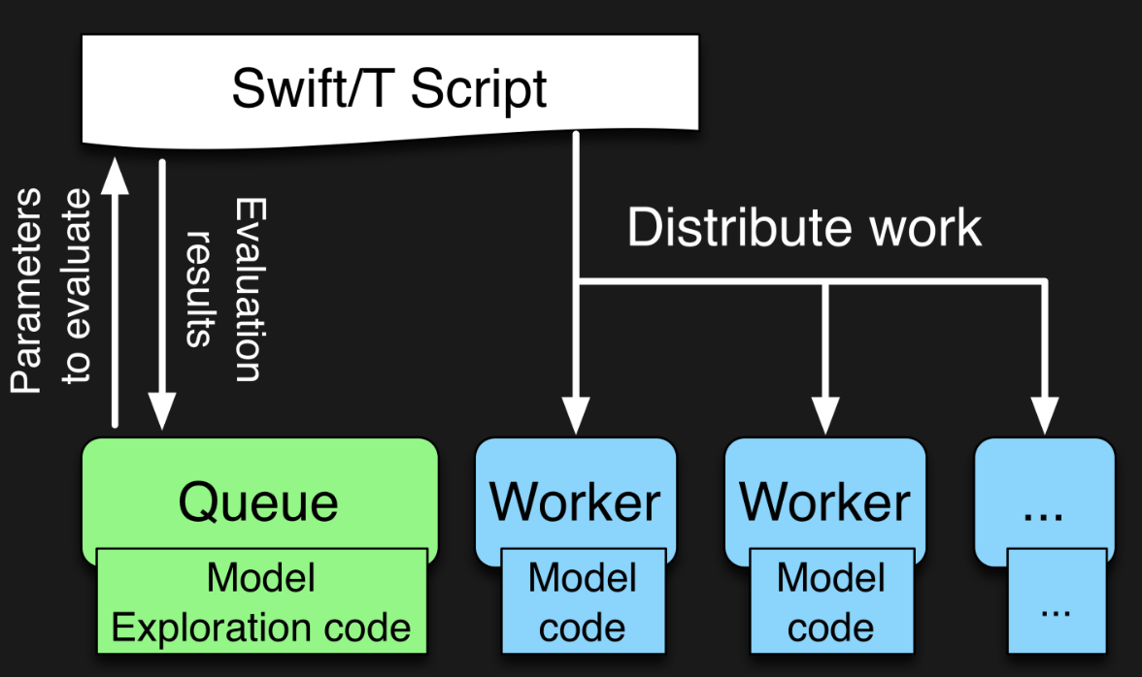

EMEWS workflow structure
The core novel contributions of EMEWS are shown in green, these allow the Swift script to access a running Model Exploration (ME) algorithm, and create an inversion of control (IoC) workflow
Both green and blue boxes accept existing multi-language code

Slide 51
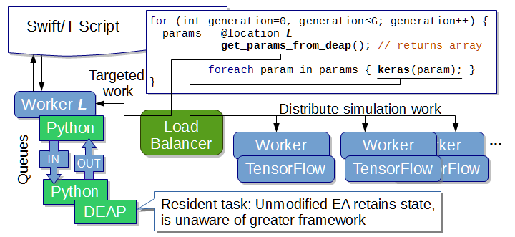
EMEWS: Extreme-scale model exploration workflows in Swift/T
To query the state of the EA, we designate one worker on location L for exclusive use by DEAP.
http://www.mcs.anl.gov/~emews/tutorial

Slide 52
Previous work on HPC workflows
Other uses of workflows to control model exploration (ME) typically take one of two approaches
They provide rich support for arithmetic operations so that ME algorithms can be constructed (ported)
requires that algorithm be coded from scratch
impossible to reuse code in other languages
The ME algorithm is provided as a built-in feature of the system
does not allow the end users much control over the algorithm used
may require access to workflow system source code in order to incorporate external ME algorithms or to modify built-in algorithms
In both cases, the many libraries being actively developed and implemented as free and open source software in programming languages such as R and Python cannot be directly/easily utilized.

Slide 53
Summary of key system points
What is different about Swift/T?
A workflow system that is actually a hierarchical programming language
Runs entirely on the compute nodes
Uses standard APIs for HPC (MPI), allows for minimal OS environment
Very high performance
Supports MPI tasks, embedded Python, R interpreters
What is different about EMEWS?
Allows user to focus on two sequential codes
The optimizer
Their objective function code
Everything else is managed by the system

Slide 54
TUTORIAL: SUPERVISOR

Slide 55
HANDS-ON TUTORIAL: SUPERVISOR
May be found here: https://github.com/ECP-CANDLE/Tutorials
See the top-level README to get started with the installation

Slide 56
FUTURE WORK

Slide 57
Directions for future work
General training workflows have been addressed by CANDLE
Tighter integration between workflow system and ML systems
What to run
Where to run
Priority
How to run
Integration with experimental and sensor-driven workflows
Integration with coupled simulation-analysis-learning workflows

Slide 58
Idealized ML Supercomputer
Embracing heterogeneity
Varying compute node accelerators: accessible in shared modes, capable of RDMA communication
Varying networks with placement groups (cheaper?)
Fast, direct external connections to external supercomputers and data streams
Workflow-optimized data movement, task assignment to resources
Scheduler features for bursty workloads, resource assignment
…
Experiments
Node 0:
GPU
Node 1:
“Normal” supercomputer
FPGA
Caches & staging
“Normal” PFS

Slide 59
Thanks
Thanks to the organizers
Code and guides:
CANDLE GitHub: https://github.com/ECP-CANDLE
Swift/T Home: http://swift-lang.org/Swift-T
EMEWS Tutorial: http://emews.org
This research was supported by the Exascale Computing Project (17-SC-20-SC), a joint project of the U.S. Department of Energy’s Office of Science and National Nuclear Security Administration, responsible for delivering a capable exascale ecosystem, including software, applications, and hardware technology, to support the nation’s exascale computing imperative.

